Slide 1
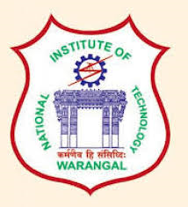
DATA STRUCTURES AND ALGORITHMS
RAILWAY MAP PLANNER

Slide 2
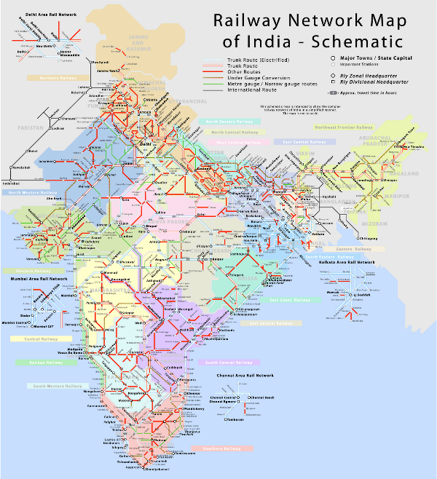
TEAM MEMBERS:
M.DURGA NAGA SAI(22EB0C03)
R.G.V.AYYAPPA(22ECB0C04)
P.VINAYAKANITESH(22ECB0C05)
V.KARTHIK(22ECB0C14)
Notes:
This is the question that your experiment answers

Slide 3
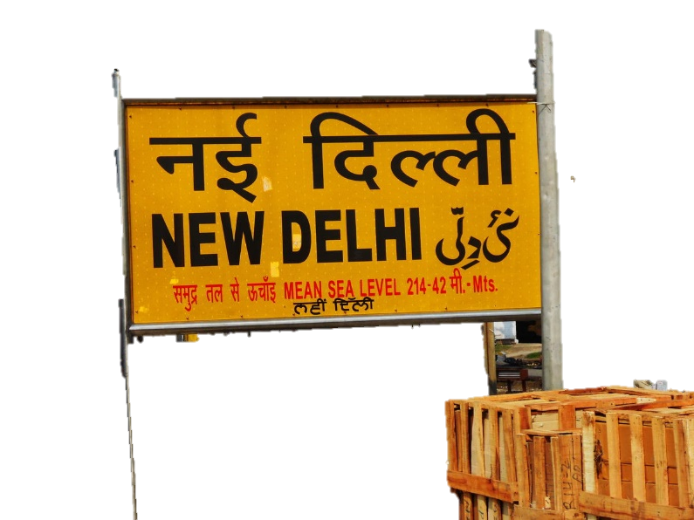
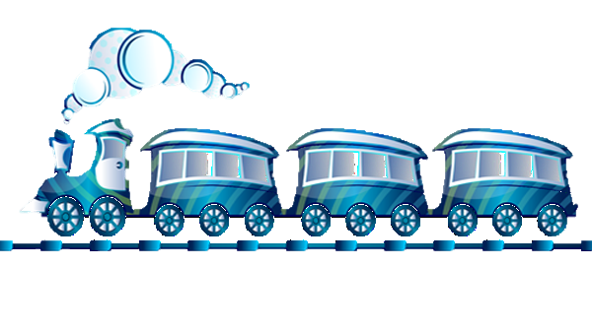
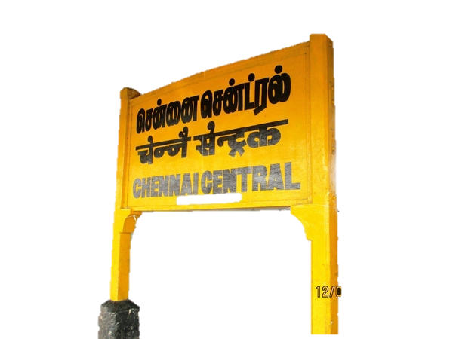
OBJECTIVE:
CONNECTING THE METRO CITIES OF INDIA USING RAILWAYS

Slide 4
METHODOLOGY:
USING GRAPHS USING UNORDERED MAPS USING HEAPS USING DIJIKSTRA’S ALGORITHM
Notes:
Summarize your research in three to five points.

Slide 5
REAL WORLD APPLICATIONS:
TIME
TRAVEL EXPENDITURE
This project helps citizens to decrement the loss of time for the passengers by giving them the shortest available route.
AVAILABLE TRAIN ROUTES
The project helps citizens to know about the available train routes and trains running between the stations
This project helps the citizens to reach the destination with minimum fare.

Slide 6
CONCLUSION:
In conclusion, the railway connection project is a significant undertaking that holds immense potential for various stakeholders involved. The project aims to establish a reliable and efficient railway network, connecting different regions and promoting economic growth, social development, and environmental sustainability.
Notes:
Establish hypothesis before you begin the experiment. This should be your best educated guess based on your research.

Slide 7
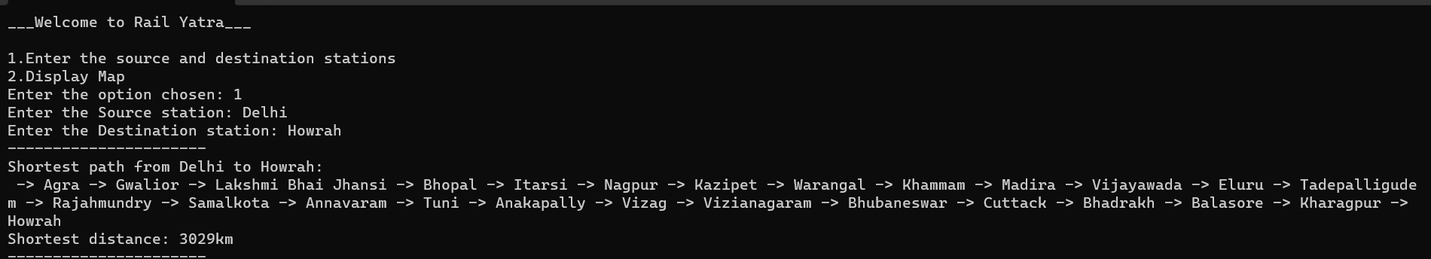
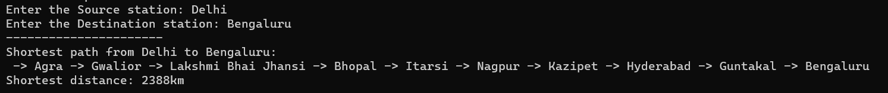
OUTPUT:

Slide 8
